Slide 1
REVIEW MODUL 11
- Array, Searching dan Sorting -
Lab Dasar FIK - 2011

Slide 2
ARRAY
Type array adalah type yang mengacu kepada sebuah atau sekumpulan elemen melalui indeks.
Array dalam bahasa indonesia disebut tabel atau larik.
Jenis dari Array:
  2 Dimensi
  3 Dimensi

Slide 3
MACAM – MACAM ARRAY
int data [5] = {5, 7, 2, 6, 9}
data[0] -> 5 , data[1] -> 7, data[2] ->2,
data[3] -> 6, data[4] -> 9
<- data
<- index
5 | 7 | 2 | 6 | 9
0 | 1 | 2 | 3 | 4

Slide 4
String : array of char
Mis : ASIK ->
char tanggal[4][10] = {apel, pisang, jeruk, nangka}
tanggal[0] -> apel ; tanggal[1] -> pisang
tanggal[2] -> jeruk ; tanggal[3] -> nangka
A | S | I | K
0 | 1 | 2 | 3

Slide 5
SEARCH (PENCARIAN DATA)
Search adalah proses pencarian sebuah data pada suatu kumpulan data
Ada beberapa teknik searching yaitu Binary Search, Sequential Search, Interpolasi Search, dll

Slide 6
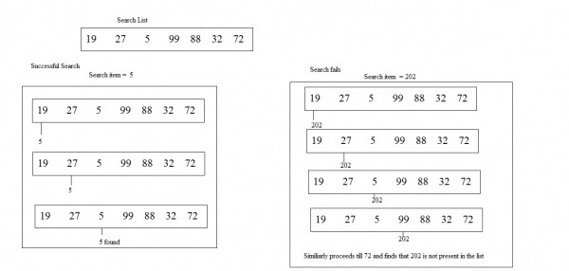
Sequential Search
Ide dari Sequential Search ini adalah dengan membandingkan hasil yang di cari satu per satu.

Slide 7
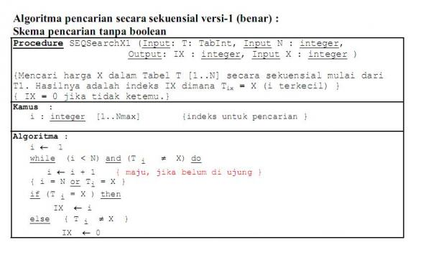
ALGORITMA

Slide 8
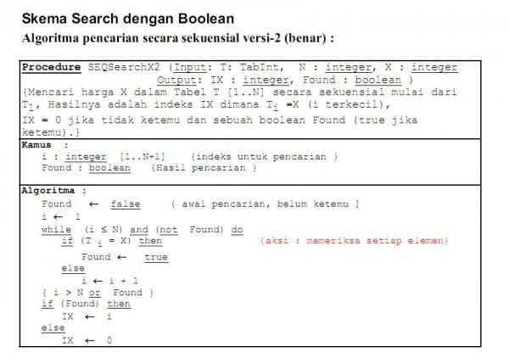
ALGORITMA

Slide 9
BINARY SEARCH
Pencarian yang dilakukan dengan cara mencari hasil yang di cari melalui perbandingan besar atau kecil dengan menggunakan rekursif

Slide 10
BINARY SEARCH FLOWCHART
BinarySearch (Key, A, LTH)
Locn = -1
Lo = 0
Hi = LTH - 1
While Hi > Lo
m = (Lo + Hi) / 2
Key = A[m]
Locn = m
Break
Key < A[m]
Hi = m-1
Lo = m+1
Return Locn
Binary Search

Slide 11
C/C++ BINARY SEARCH FCN
//--------------------------------------------
// Binary Search Algorithm:
// Divide the remaining table in half
// Check the midpoint; if found, DONE
// If not found, consider the first half
// or second half, depending...
// and do Binary Search on it
// If the partition size goes to ONE, the
// item is NOT present in the table
//--------------------------------------------
int BinarySearch (const int nKey,
const int nArray [],
const int nLth)
{
int nLoc = -1, nLow = 0, nHigh = nLth-1;
while (nHigh >= nLow) {
int m = (nLow + nHigh) / 2;
if (nKey == nArray [m])
{ nLoc = m; break; }
if (nKey < nArray [m])
nHigh = m - 1;
else
nLow = m + 1;
}
return nLoc;
}
Binary Search

Slide 12
SORTING (PENGURUTAN DATA)
Sorting adalah proses pengolahan data agar terurut
Ada beberapa teknik sorting yaitu Bubble Sort, Count Sort, Selection Sort, Insertion Sort, dll

Slide 13
SORT
void Sort (int T[ ], int N){
int x; int pass; int temp;
for(pass=1;pass<=N-1;pass++){
for(x=pass+1;x<=N;x++){
if((T[pass])>(T[x])) {
temp= (T[x]);
(T[x]) = (T[pass]);
(T[pass]) = temp;
}
}
}
}

Slide 14
Data Awal
5 | 1
2 | 2
4 | 3
8 | 4
1 | 5

Slide 15
pass = 1
x = 2
5 | 1
2 | 2
4 | 3
8 | 4
1 | 5
T [ pass ] => T [ 1 ] = 5
T [ x ] => T [ 2 ] = 2
Apakah T [ pass ] > T [ x ] ? Ya , 5 > 2
Maka tukar ….

Slide 16
pass = 1
x = 2
5 | 1
2 | 2
4 | 3
8 | 4
1 | 5
T [ x ] => T [ 2 ] = 2
T [ x – 1 ] => T [ 1 ] = 5
Apakah T [ x ] < T [ x – 1 ] ? Ya , 2 < 5
Maka tukar ….

Slide 17
pass = 1
x = 2
2 | 1
5 | 2
4 | 3
8 | 4
1 | 5

Slide 18
pass = 1
x = 3
2 | 1
5 | 2
4 | 3
8 | 4
1 | 5
T [ pass ] => T [ 1 ] = 2
T [ x ] => T [ 3 ] = 4
Apakah T [ pass ] > T [ x ] ? Tidak , 2 !> 4
Maka tetap ….

Slide 19
pass = 1
x = 4
2 | 1
5 | 2
4 | 3
8 | 4
1 | 5
T [ pass ] => T [ 1 ] = 2
T [ x ] => T [ 4 ] = 8
Apakah T [ pass ] > T [ x ] ? Tidak , 2 !> 8
Maka tetap ….

Slide 20
pass = 1
x = 5
2 | 1
5 | 2
4 | 3
8 | 4
1 | 5
T [ pass ] => T [ 1 ] = 2
T [ x ] => T [ 5 ] = 1
Apakah T [ pass ] > T [ x ] ? Ya , 2 > 1
Maka tukar ….

Slide 21
pass = 1
x = 5
2 | 1
5 | 2
4 | 3
8 | 4
1 | 5
T [ pass ] => T [ 1 ] = 2
T [ x ] => T [ 5 ] = 1
Apakah T [ pass ] > T [ x ] ? Ya , 2 > 1
Maka tukar ….

Slide 22
pass = 1
x = 5
1 | 1
5 | 2
4 | 3
8 | 4
2 | 5

Slide 23
pass = 2
x = 3
1 | 1
5 | 2
4 | 3
8 | 4
2 | 5
T [ pass ] => T [ 2 ] = 5
T [ x ] => T [ 3 ] = 4
Apakah T [ pass ] > T [ x ] ? Ya , 5 > 4
Maka tukar ….

Slide 24
pass = 2
x = 3
1 | 1
5 | 2
4 | 3
8 | 4
2 | 5
T [ pass ] => T [ 2 ] = 5
T [ x ] => T [ 3 ] = 4
Apakah T [ pass ] > T [ x ] ? Ya , 5 > 4
Maka tukar ….

Slide 25
pass = 2
x = 3
1 | 1
4 | 2
5 | 3
8 | 4
2 | 5

Slide 26
pass = 2
x = 4
1 | 1
4 | 2
5 | 3
8 | 4
2 | 5
T [ pass ] => T [ 2 ] = 4
T [ x ] => T [ 4 ] = 8
Apakah T [ pass ] > T [ x ] ? Ya , 4 !> 8
Maka tetap ….

Slide 27
pass = 2
x = 5
1 | 1
4 | 2
5 | 3
8 | 4
2 | 5
T [ pass ] => T [ 2 ] = 4
T [ x ] => T [ 5 ] = 2
Apakah T [ pass ] > T [ x ] ? Ya , 4 > 2
Maka tukar ….

Slide 28
pass = 2
x = 5
1 | 1
4 | 2
5 | 3
8 | 4
2 | 5
T [ pass ] => T [ 2 ] = 4
T [ x ] => T [ 5 ] = 2
Apakah T [ pass ] > T [ x ] ? Ya , 4 > 2
Maka tukar ….

Slide 29
pass = 2
x = 5
1 | 1
2 | 2
5 | 3
8 | 4
4 | 5

Slide 30
pass = 3
x = 4
1 | 1
2 | 2
5 | 3
8 | 4
4 | 5
T [ pass ] => T [ 3 ] = 5
T [ x ] => T [ 4 ] = 8
Apakah T [ pass ] > T [ x ] ? Ya , 5 !> 8
Maka tetap ….

Slide 31
pass = 3
x = 5
1 | 1
2 | 2
5 | 3
8 | 4
4 | 5
T [ pass ] => T [ 3 ] = 5
T [ x ] => T [ 5 ] = 4
Apakah T [ pass ] > T [ x ] ? Ya , 5 > 4
Maka tukar ….

Slide 32
pass = 3
x = 5
1 | 1
2 | 2
5 | 3
8 | 4
4 | 5
T [ pass ] => T [ 3 ] = 5
T [ x ] => T [ 5 ] = 4
Apakah T [ pass ] > T [ x ] ? Ya , 5 > 4
Maka tukar ….

Slide 33
pass = 3
x = 5
1 | 1
2 | 2
4 | 3
8 | 4
5 | 5

Slide 34
pass = 4
x = 5
1 | 1
2 | 2
4 | 3
8 | 4
5 | 5
T [ pass ] => T [ 4 ] = 8
T [ x ] => T [ 5 ] = 5
Apakah T [ pass ] > T [ x ] ? Ya , 8 > 5
Maka tukar ….

Slide 35
pass = 4
x = 5
1 | 1
2 | 2
4 | 3
8 | 4
5 | 5
T [ pass ] => T [ 4 ] = 8
T [ x ] => T [ 5 ] = 5
Apakah T [ pass ] > T [ x ] ? Ya , 8 > 5
Maka tukar ….

Slide 36
pass = 4
x = 5
1 | 1
2 | 2
4 | 3
5 | 4
8 | 5

Slide 37
Data terurut
1 | 1
2 | 2
4 | 3
5 | 4
8 | 5

Slide 38
TYPEDEF
Keyword khusus yang memberikan nama alternatif terhadap suatu tipe.
Contoh :
//deklarasi tipe data baru “DataInt”, merupakan array data bertipe integer
typedef int DataInt[maxdata];
//”DataInt” di inisialisasi menjadi tipe data baru, dengan nama “data1”
DataInt data1= {2,42,32,12};

Slide 39
Sekian Dan Terima Kasih
Ada Pertanyaan??

